Slide 1
Heart Disease Health Indicators
By: Robin Bertolini, Ebtesam Seram, Daniel Harrod, Anthony Parras

Slide 2
Data Sources
Content The Behavioral Risk Factor Surveillance System (BRFSS) is an annual health-related telephone survey conducted by the Centers for Disease Control and Prevention (CDC). The study collects responses on health-related risk behaviors, chronic health conditions, and the utilization of prevention strategies. We used a csv of the dataset available on Kaggle for 2015 for this project. This dataset contains 253,680 survey responses from the cleaned BRFSS 2015, which will be used mostly for binary heart disease categorization. This dataset contains 229,787 respondents that say they don't have/haven't had heart disease, whereas 23,893 say they have.
This dataset was retrieved from the https://www.kaggle.com/murattademir/heart-disease-binary-classification/data .

Slide 3
Reason for Topic:
Heart disease is one of the most common chronic diseases in the United States, affecting millions of people each year and costing the economy a large amount of money. Heart disease kills over a half million people in the United States each year, making it the leading cause of death. In this dataset we will explore the common health indicators that are used to factor in heart disease risk.
The following questions are to be investigated:
Can we use the features to forecast the risk of heart disease?
Can we use combinations of the features to get higher correlations with heart disease risk?
Can we determine if preventive care screening leads to lowering heart disease risk?

Slide 4
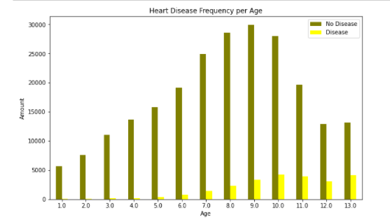
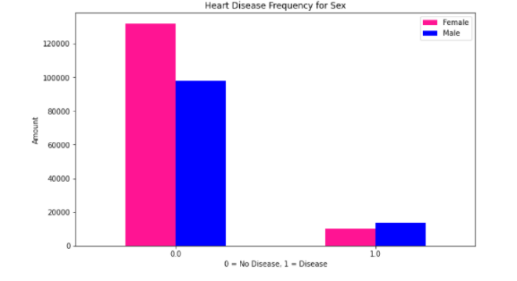
Data Exploration of Single Features

Slide 5
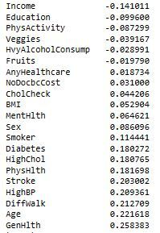
Data Analysis - Single feature correlation
Top five features correlation:
General health condition 25%
Age 22%
High blood pressure 21%
Poor mobility 21%
Past stroke 20%

Slide 6
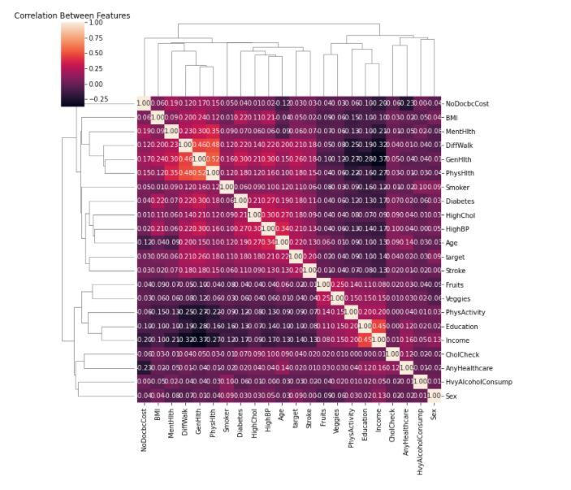
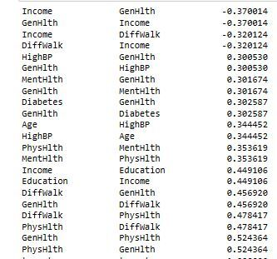
Data Analysis - Paired feature correlation
When features are combined we find greater correlation

Slide 7
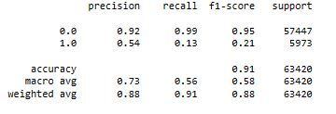
Logistic Regression - Classification Report
Classification report shows the sqw of data by the differences of the

Slide 8
Results of Analysis
We found the data to be heavily skewed towards No Disease. This presented a problem with determining if our machine learning was really accurate.
We found if we combined features into pairs there was greater correlation between the target value.
Recommendations for future/What we would have done differently
With a heavily skewed dataset we could try in the future different algorithms
Oversampling - to bring our smaller With Disease target values in scale with No Disease target values
Undersampling - to cut down our larger No Disease target values to be in scale with our smaller set of With Disease target values
SMOTEEN algorithm - would be a combination of over and under sampling

Slide 9
Technologies Used
We created a SQLite database. We chose this method to be able to easily pass the database as a flat file instead of having to setup a server environment.
Python libraries used for visualizations, sql, and machine learning: Pandas, Numpy, Matplotlib, Plotly, Sklearn, (add sql library here).
Machine Learning algorithm - Logistic Regression
Tableau was used for our dashboards

